Slide 1
PYTHON

Slide 2
LEARNING OBJECTIVES
At the end of this lesson, you should be able to
List the important data types supported by Python
Discuss data structures, such as lists, tuples, sets, and dicts
Explain slicing and accessing the four data structures
Discuss basic operators and functions
Outline the important control flow statement

Slide 3
Anaconda: The World's Most Popular Data Science Platform
The following are some of the reasons why Anaconda is one of the best Data Science platforms:
Open source Python distribution
Enterprise-ready Data Analytics platform
Modern Data Science analytics architecture
Multi-workload Data Analytics
400+ popular Python packages
Interactive visualizations, governance, security, and operational support

Slide 4
Installation of Anaconda Python Distribution
You can install and run the Anaconda Python distribution on windows as follows
Website URL:
https://www.continuum.io/downloads
Graphical Installer
• Download the graphical installer.
• Double-click the .exe file to install Anaconda and follow the instructions on the screen

Slide 5
Jupyter Notebook
Jupyter is an open source and interactive web-based Python interface for Data Science and scientific computing.
Some of the advantages are
Python language support
Big Data platform integration
Content sharing and contribution
Built-in interactive widgets

Slide 6
Reserved words
if | print | for | while | input | is
break | False | True | class | return | None
and | as | try | assert | def | except
yield | in | import | pass | with | continue
finally | global | from | lambda | not | del
raise | finally | nonlocal

Slide 7

Variables and Assignment
A variable can be assigned or bound to any value. Some of the characteristics of binding a variable in Python are listed here:
The variable refers to the memory location of the assigned value.

Slide 8
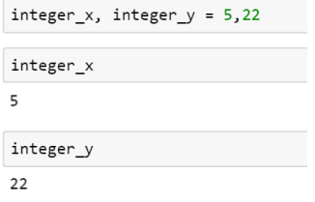
Multiple Assignments
You can access a variable only if it is defined. You can define multiple variables simultaneously.

Slide 9
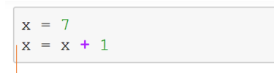
Assignment and Reference
When a variable is assigned a value, it refers to the value’s memory location or address. It does not equal the value itself.

Slide 10
OPERATOR AND OPERATIONS
Operator | Operations
+ | Addition
_ | Subtraction
/ | Division
* | Multiplication
** | Power
% | Remainder
== | Equal to
!= | Not equal to

Slide 11
Operator precedence rule
Highest precedence rule to lowest precedence rule
Paranthesis
Exponentiation
Multiplication, Division and Remainder
Addition and Subtraction
Left to right
Example: 1 + 2 ** 3 / 4 * 5
1 + 8/4*5
1+ 2*5
1+10
11

Slide 12
BREAKFAST
Solve for the variables in the following if a = 1, b = 7, c = 10 and d =20
i. a + b
Ii. a + b – c
Iii. (a*d) / c
iv. (a*c) + (d * b)
v. (b**2) + a

Slide 13
ATTEMPT
Write a python code to calculate the following
The area of a Stadium of length 500m and breadth 200m (Hint: Area = length x breadth)
The volume of a tank of length 240cm, breadth 160cm and 268cm wide. (Hint: Volu me = Length x breadth x width
The simple interest at a principal of 250,000 naira, rate of 6% and in two years. [Hint: Simple Interest =( principal x rate x time)/100
Goods in a container cost 120,000,000 naira. If the goods were sold at 150,000,000 naira, what is the percentage profit on the gooods. [Hint: profit = Selling price – cost price]
[Percentage profit = (profit/cost price) x 100]

Slide 14
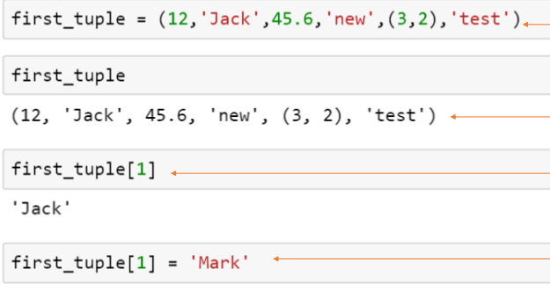
DATA STRUCTURE :TUPLE
A tuple is a one-dimensional, immutable ordered sequence of items which can be of mixed data types

Slide 15
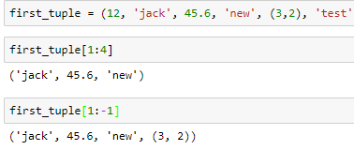
Slicing tuples
You can also slice a range of elements by specifying the start and end indices of the desired range

Slide 16
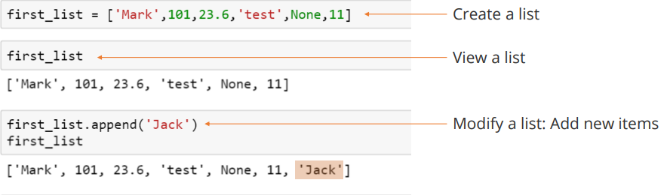
DATA STRUCTURE : LIST
A list is a one-dimensional, mutable ordered sequence of items which can be of mixed data types.

Slide 17
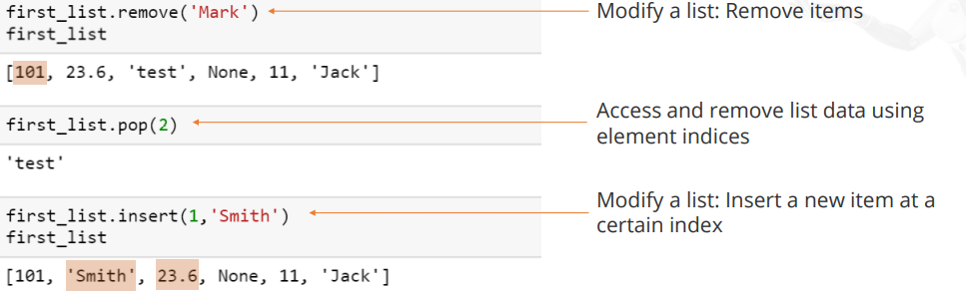

Slide 18
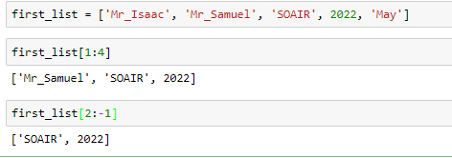
Slicing in List
Slicing in list is similar to that of tuples

Slide 19
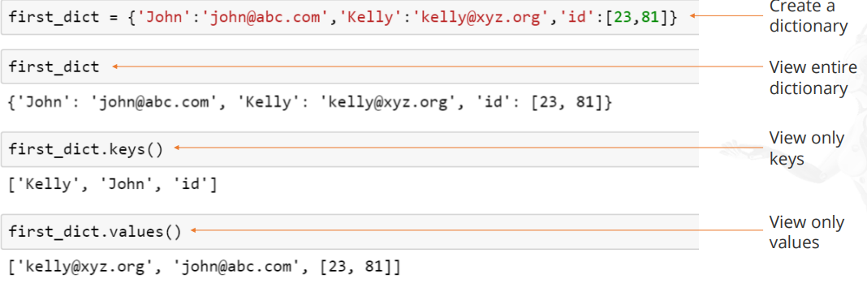
DATA STRUCTURE : DICTIONARY
Dictionaries store a mapping between a set of keys and a set of values
You can view the keys and values in a dictionary, either separately or together, using the syntax shown here.

Slide 20
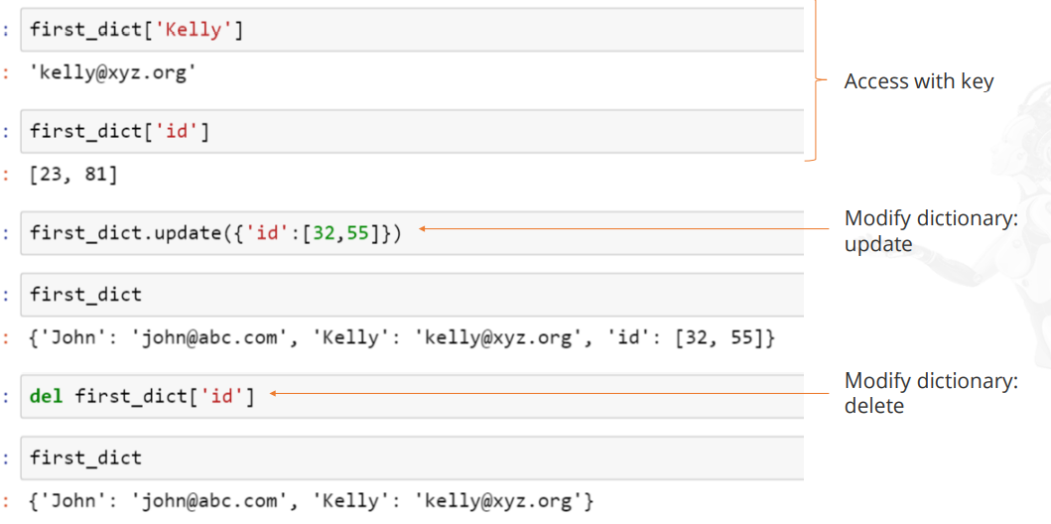
You can also access and modify individual elements in a dict.

Slide 21
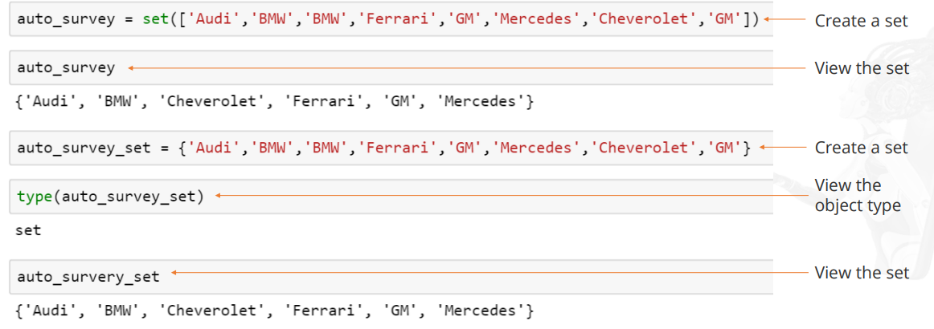
DATA STRUCTURE : SET
A set is an unordered collection of unique elements

Slide 22
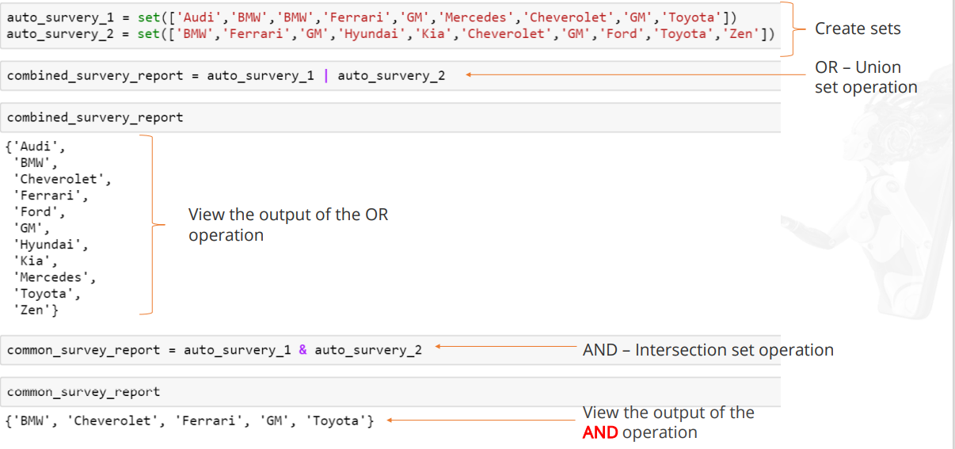
DATA STRUCTURE : SET OPERATIONS

Slide 23
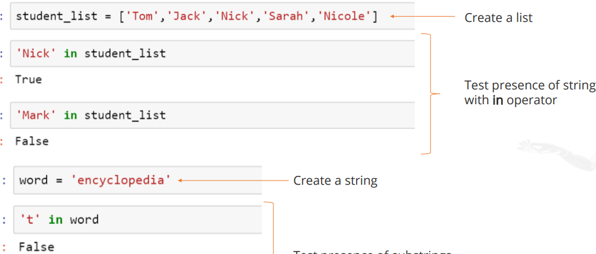
BASIC OPERATOR : IN
The in operator is used to generate a Boolean value to indicate whether a given value is present in the container or not.

Slide 24
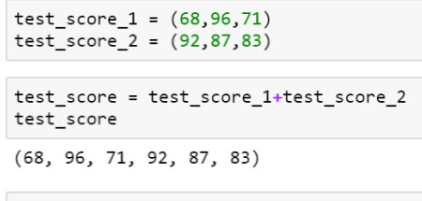
Basic Operator: +
The plus operator produces a new tuple, list, or string whose value is the concatenation of its arguments.

Slide 25
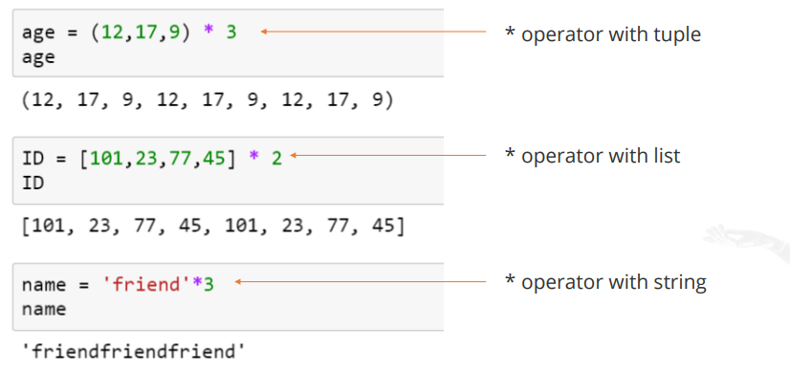
Basic Operator: *
The multiplication operator produces a new tuple, list, or string that repeats the original content.

Slide 26
Functions: Considerations
Some important points to consider while defining functions:
A function should always have a return value.
If return is not defined, then it returns None.
Function overloading is not permitted.

Slide 27
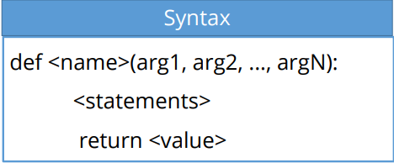
FUNCTIONS
Functions are the primary and most important method of code organization and reuse in Python.
Outcome of the function is communicated by return statement
Arguments in parenthesis are basically assignments

Slide 28
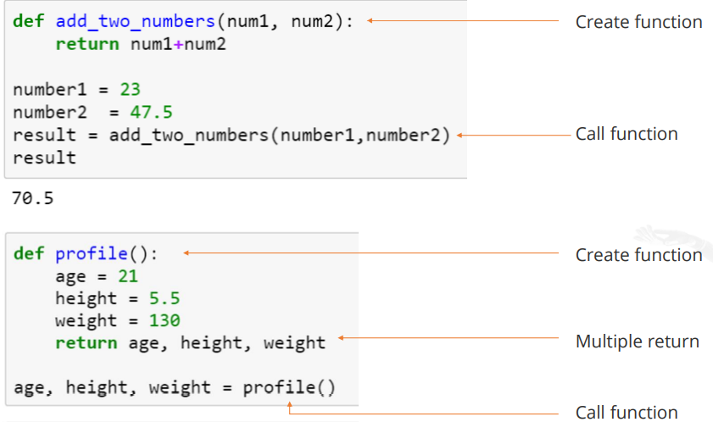
Functions: Returning Values
You can use a function to return a single value or multiple values

Slide 29
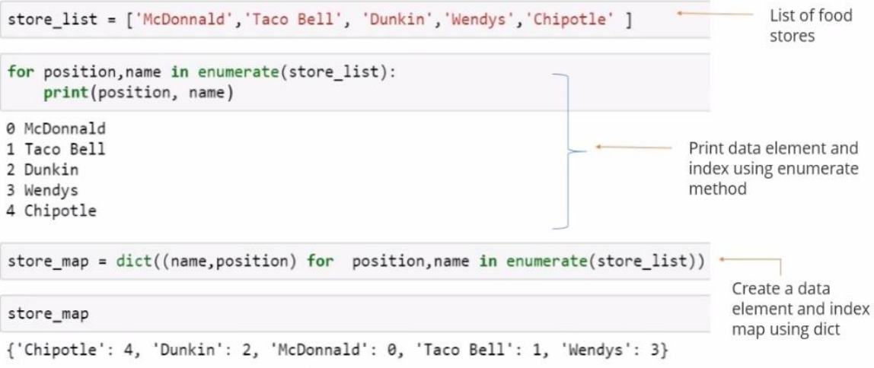
Built-in Sequence Functions: enumerate

Slide 30
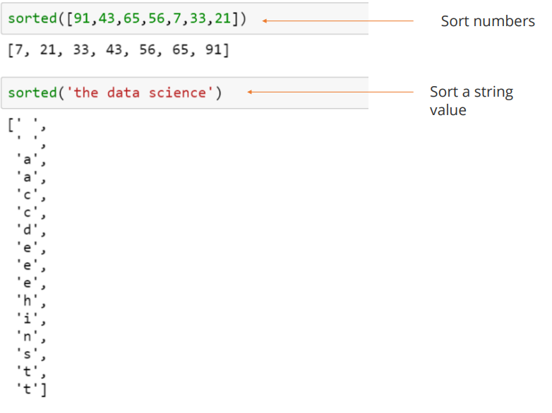
Built-in Sequence Functions: sorted

Slide 31
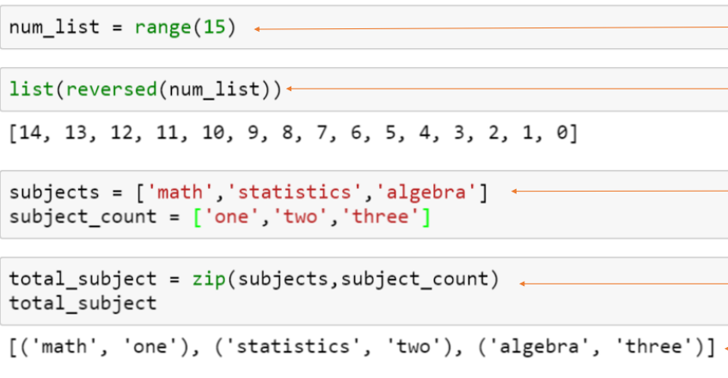
Built-in Sequence Functions: reversed and zip

Slide 32
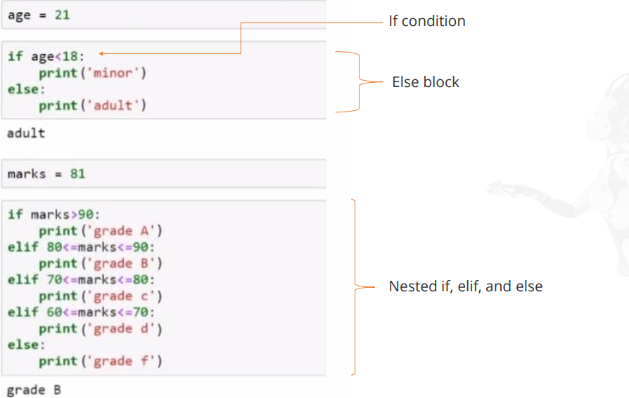
Control Flow Statements: if, elif, else

Slide 33
Control Flow Statements : for Loops
A for loop is used to iterate over a collection (like a list or tuple) or an iterator.
A for loop statement can be accompanied by a break or continue statement

Slide 34
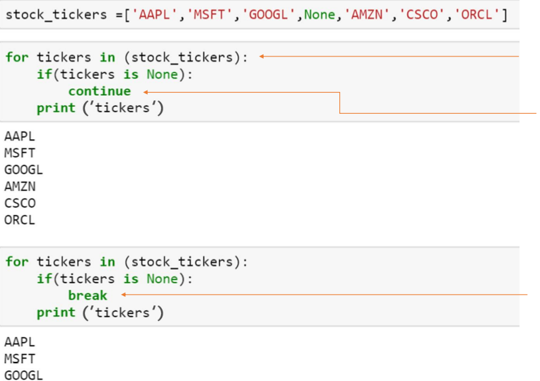

Slide 35
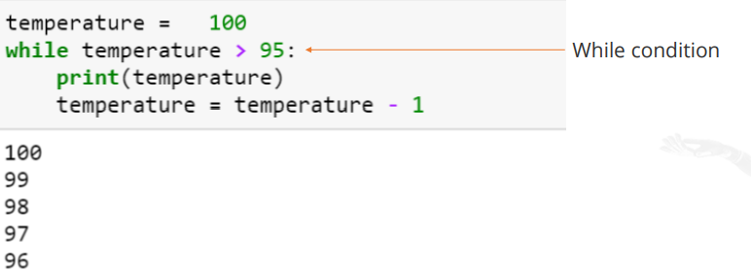
Control Flow Statements : while Loops
A while loop specifies a condition and a block of code that is to be executed until the condition evaluates to False or the loop is explicitly ended with break

Slide 36
QUESTIONS ON WHILE LOOP AND FOR LOOP
1. Write a program to print the following using while loop
A. First 10 Even numbers
B. First 10 Odd numbers
C. First 10 Natural numbers
D. First 10 Whole numbers
2. Write a program to print first 10 integers and their squares using while loop.
1 1
2 4 and so on

Slide 37
3. Write a while loop statement to print the following series:
10, 20, 30….300
4. Write a while loop statement to print the following series
105, 98, 91…..7
5. Write a program to print first 10 natural number in reverse order usimg while loop

Slide 38
Explore your potential
Print all the numbers between 1 to 100 that are divisible by 17
Print numbers between 300 to 500 that are divisible by both 2 and 6

